Slide 1
Lecture-05

Slide 2
Previous Lecture summary:
Container orchestration automates the provisioning, scaling, deployment, availability, Load-balancing, and lifecycle management of containers.
Kubernetes is orchestrates containerized tool to run on a cluster of hosts.
A Kubernetes cluster is a set of nodes that run containerized applications.
Nodes are VMs or physical servers that host containerized applications
Image Registry: Container images are kept in the registry and transferred to nodes by the control plane for execution in container pods.
Pods are where containerized applications run.

Slide 3
Contents
Cloud Service Providers
Microsoft Azure
Amazon Web Services (Aws)
Google Cloud Platform
Difference between GCP, AWS and Azure
Automated Deployment To Cloud Azure
Create Azure Kubernetes Cluster

Slide 4
Cloud Service Providers
Cloud Service providers (CSP) offers various services such as:
  Software as a Service
  Platform as a service
  Infrastructure as a service
  Network services
  Servers and data storage
The cloud service providers host these services in a data center.
Users can access these services through cloud provider companies using an Internet connection.

Slide 5
Cloud Service Providers (Cont.)
Cloud Service Providers Companies -
  Microsoft Azure
  Amazon Web Services (AWS)
  Google Cloud Platform
  Alibaba Cloud, and Many More.

Slide 6
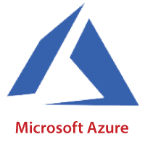
Microsoft Azure
Azure is a cloud computing platform that can provide everything a business needs to run all or part of its computing operations virtually—including servers, storage, databases, networking, analytics and more.
It helps the organizations in building, testing, deploying, and managing applications and services through Microsoft-managed data centers.

Slide 7
Features of Microsoft Azure
Microsoft Azure provides scalable, flexible, and cost-effective
It allows developers to quickly manage applications and websites.
It managed each resource individually.
Its IaaS infrastructure allows us to launch a general-purpose virtual machine in different platforms such as Windows and Linux.
It offers a Content Delivery System (CDS) for delivering the Images, videos, audios, and applications.

Slide 8
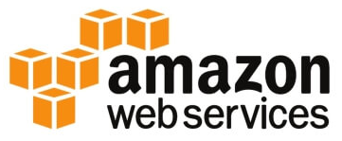
Amazon Web Services (AWS)
AWS (Amazon Web Services) is a secure cloud service platform provided by Amazon.
It offers various services such as database storage, computing power, content delivery, Relational Database, Simple Email, and other functionality to increase the organization's growth.
AWS EC2 (Elastic Compute Cloud) offers core compute services.
Amazon EC2 is a web service that provides resizable compute capacity in the cloud.

Slide 9
Features of AWS
AWS is scalable because it has an ability to scale the computing resources up or down according to the organization's demand.
AWS is cost-effective as it works on a pay-as-you-go pricing model.
It provides various flexible storage options.
It offers various security services such as infrastructure security, data encryption, monitoring & logging, identity & access control.
It can efficiently manage and secure Windows workloads.

Slide 10
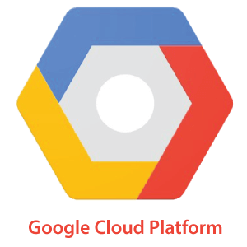
Google Cloud Platform (GCP)
Google Cloud Platform (GCP) is a suite of cloud computing services provided by Google.
It is a public cloud computing platform consisting of a variety of services like compute, storage, networking, application development, Big Data, and more, which run on the same cloud infrastructure that Google uses internally for its end-user products, such as Google Search, Photos, Gmail and YouTube, etc.
The services of GCP can be accessed by software developers, cloud administrators and IT professionals over the Internet or through a dedicated network connection.

Slide 11
Features of GCP
Google cloud includes various big data services such as Google BigQuery, Google CloudDataproc, Google CloudDatalab, and Google Cloud Pub/Sub.
It provides various services related to networking, including Google Virtual Private Cloud (VPC), Content Delivery Network, Google Cloud Load Balancing, Google Cloud Interconnect, and Google Cloud DNS.
It offers various scalable and high-performance
GCP provides various serverless services such as Messaging, Data Warehouse, Database, Compute, Storage, Data Processing, and Machine learning (ML)
It provides a free cloud shell environment with Boost Mode.

Slide 12
Differences GCP, AWS and Azure
Some of the main differences between GCP, AWS and Azure:
Google Cloud | AWS | Azure
It uses GCE (Google Compute Engine) for computing purposes. | AWS EC2 offers core compute services. | It uses virtual machines for computation purposes.
It uses Google Cloud Storage for storage purposes. | It uses Amazon S3 (Amazon Simple Storage Service) for storing the data. | It uses a storage block bob that comprises blocks for storing the data.
It offers the lowest price to the customers to beat other cloud providers. | AWS pricing is generally keen to have inscrutable. The overall structure of granular pricing is a bit complex. | Like AWS, Azure pricing structure is also difficult to understand unless you have considerable experience.

Slide 13
Differences GCP, AWS and Azure (Cont.)
Google Cloud | AWS | Azure
It uses Cloud Test labs for App Testing purposes. | It uses a device farm for App Testing purposes. | It uses DevTest labs for App Testing purposes.
It uses Subnet as a virtual network. | It uses VPC as a virtual network. | It uses VNet as a virtual Network.
It follows the Cloud Load Balancing configuration. | It follows the Elastic Load Balancing configuration. | It follows the Load-Balancer Application Gateway configuration.

Slide 14
Azure Services
Compute services: It includes the Microsoft Azure Cloud Services, Azure Virtual Machines, Azure Website, and Azure Mobile Services, which processes the data on the cloud with the help of powerful processors.
Data services: This service is used to store data over the cloud that can be scaled according to the requirements. It includes Microsoft Azure Storage (Blob, Queue Table, and Azure File services), Azure SQL Database, and the Redis Cache.
Application services: It includes services, which help us to build and operate our application, like the Azure Active Directory, Service Bus for connecting distributed systems, HDInsight for processing big data, the Azure Scheduler, and the Azure Media Services.
Network services: It helps you to connect with the cloud and on-premises infrastructure, which includes Virtual Networks, Azure Content Delivery Network, and the Azure Traffic Manager.

Slide 15
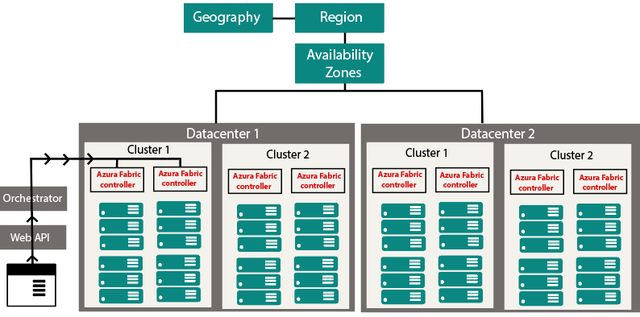
How Azure works
The internal workings of Azure so that we can design our applications on Azure effectively with high availability, data residency, resilience, etc.
Azure works Flow Structure

Slide 16
How Azure works (Cont.)
Microsoft Azure is completely based on the concept of virtualized data center.
It also contains racks.
Each rack has a separate power unit and network switch, and also each rack is integrated with a software called Fabric-Controller.
This Fabric-controller is a distributed application, which is responsible for managing and monitoring servers within the rack.
Each of these Fabric-Controller is, in turn, connected to a piece of software called Orchestrator.
This Orchestrator includes web-services, Rest API to create, update, and delete resources.

Slide 17
How Azure works (Cont.)
Request is made by the user either using PowerShell or Azure portal.
First, it will go to the Orchestrator, where it will fundamentally do three things:
  Authenticate the User
  It will Authorize the user, i.e., it will check whether the user is allowed to do the requested task.
  It will look into the database for the availability of space based on the resources and pass the request to an appropriate Azure Fabric controller to execute the request.

Slide 18
How Azure works (Cont.)
Combinations of racks form a cluster.
There are multiple clusters within a data center, and we can have multiple Data Centers within an Availability zone, multiple Availability zones within a Region, and multiple Regions within a Geography.
Geographies: It is a discrete market, typically contains two or more regions, that preserves data residency and compliance boundaries.
Azure regions: A region is a collection of data centers deployed within a defined perimeter and interconnected through a dedicated regional low-latency network.

Slide 19
Automated Deployment Azure Cloud
Azure Kubernetes Service (AKS)
  AKS allows you to automated deploy a production ready Kubernetes cluster in Azure.
https://docs.microsoft.com/en-us/azure/aks/

Slide 20
Create Azure Kubernetes Cluster
There are 4 ways to deploy an Azure Kubernetes Cluster, which are using:
  Azure Portal
  Azure CLI
  Azure PowerShell
  Using template-driven deployment options

Slide 21
Steps To Create AKS Cluster
Now let us look at how do we create a cluster using Azure Portal.
But before all that you should an Azure Cloud account to create a cluster. Create a FREE TRIAL AZURE ACCOUNT to get $200 free credit on your Azure portal.

Slide 22
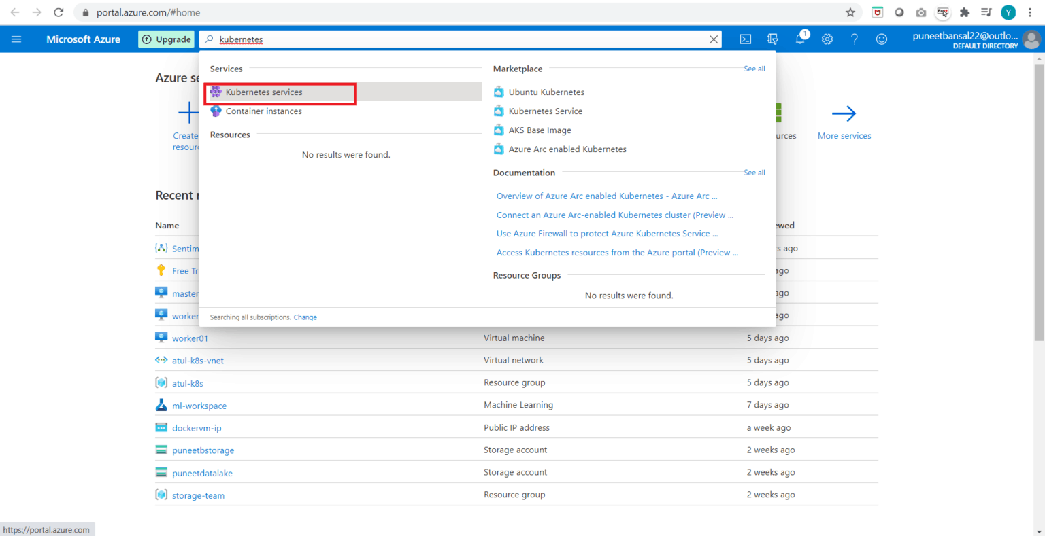
Steps To Create AKS Cluster
Step 1 [Kubernetes Services]: Go to the Azure Portal and search for Kubernetes Service in the search bar and click on it.

Slide 23
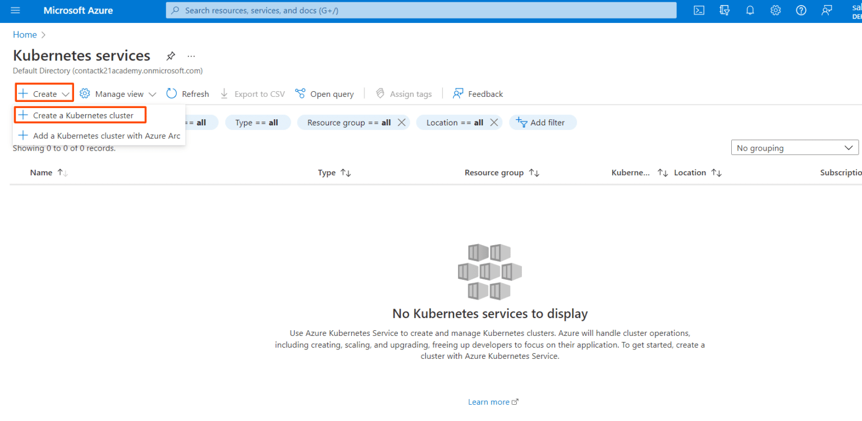
Steps To Create AKS Cluster (Cont.)
Step 2 [Add Kubernetes Cluster]: Once you reach the Kubernetes Services page, click on Create and then Create Kubernetes Cluster.

Slide 24
Steps To Create AKS Cluster (Cont.)
Step 3 [Basics]: Once you click on add Kubernetes cluster, the next step is to update the specifications of the cluster. So, click on Basics.
  Give the Resource Group name as per your requirement.
  Specify a name to your cluster in the Kubernetes cluster name field.
  Choose a Region in which you want to create your AKS cluster. In the specified region, our master node will be created.
  Based on the region the select the availability zones.
  Select the Kubernetes Version. Here I am choosing the default, i.e., 1.20.9

Slide 25
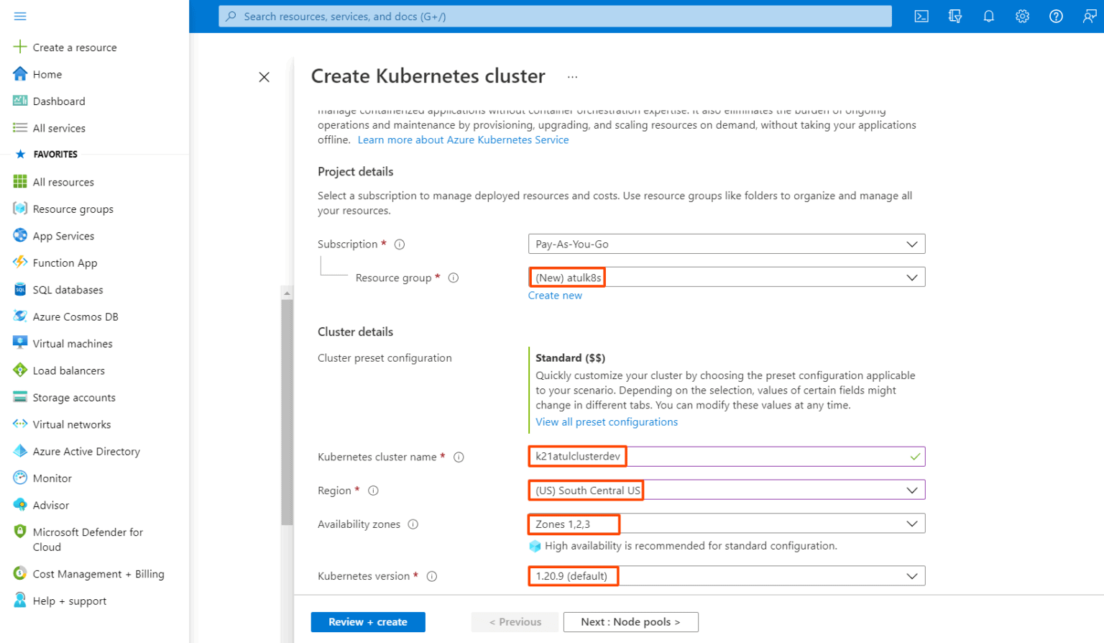
Steps To Create AKS Cluster (Cont.)
Step 3 [Basics]:

Slide 26
Steps To Create AKS Cluster (Cont.)
Step 3 [Basics]:
  Next, comes the size and count of the nodes of the AKS cluster that we are gonna create. These can be updated as per the requirements.
    Select the Node Size. We are choosing Standard Ds2 v2 which has the following configuration: 2 vCPUs, 7 GB RAM, 8 Data Disks, 14 GB Temp Storage.
    Give the Node Count value which specifies how many Worker Nodes we want.

Slide 27
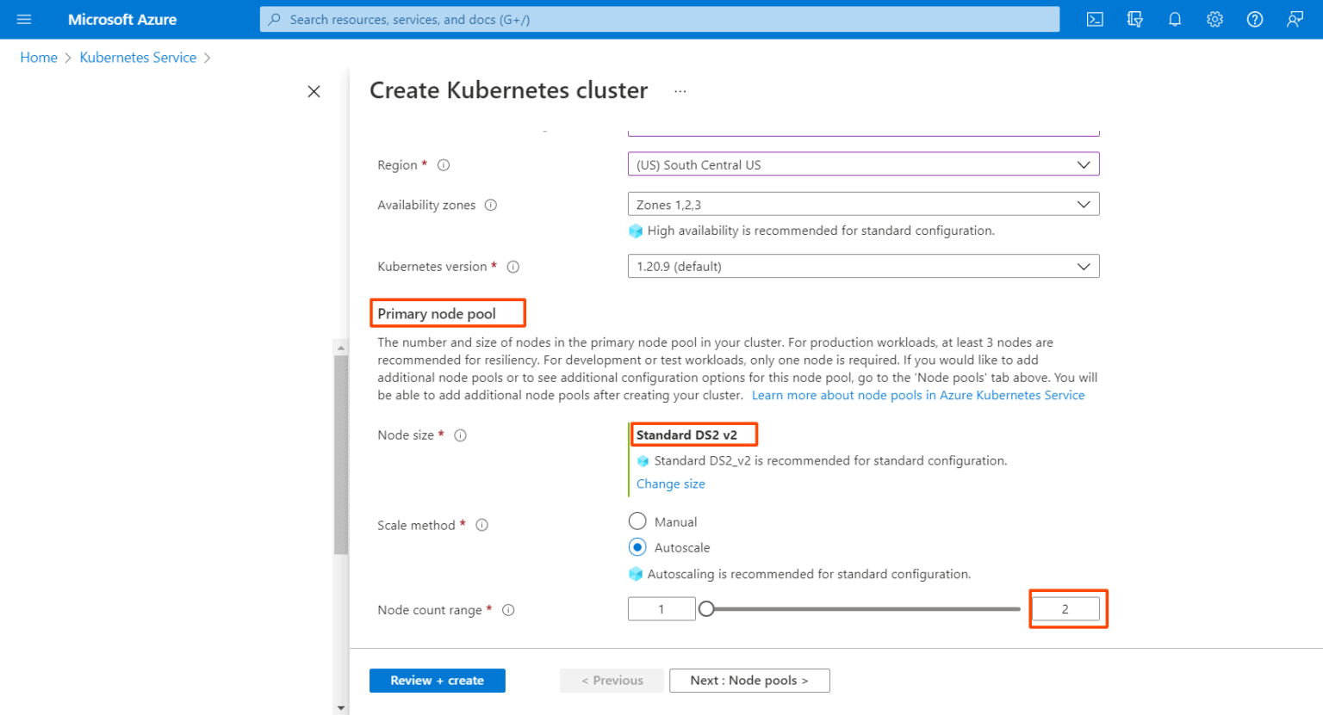
Steps To Create AKS Cluster (Cont.)
Step 3 [Basics]:

Slide 28
Steps To Create AKS Cluster (Cont.)
Step 4 [Node Pools]: Next comes the Node Pools, follow the steps given below:
In Azure Kubernetes Service (AKS), nodes of the same configuration are grouped together into node pools. Node pools contain the underlying VMs that run your applications.
The Virtual nodes are a type of Serverless container instance. As we want to create the Worker nodes as Virtual Machines, so we won’t enable this option.

Slide 29
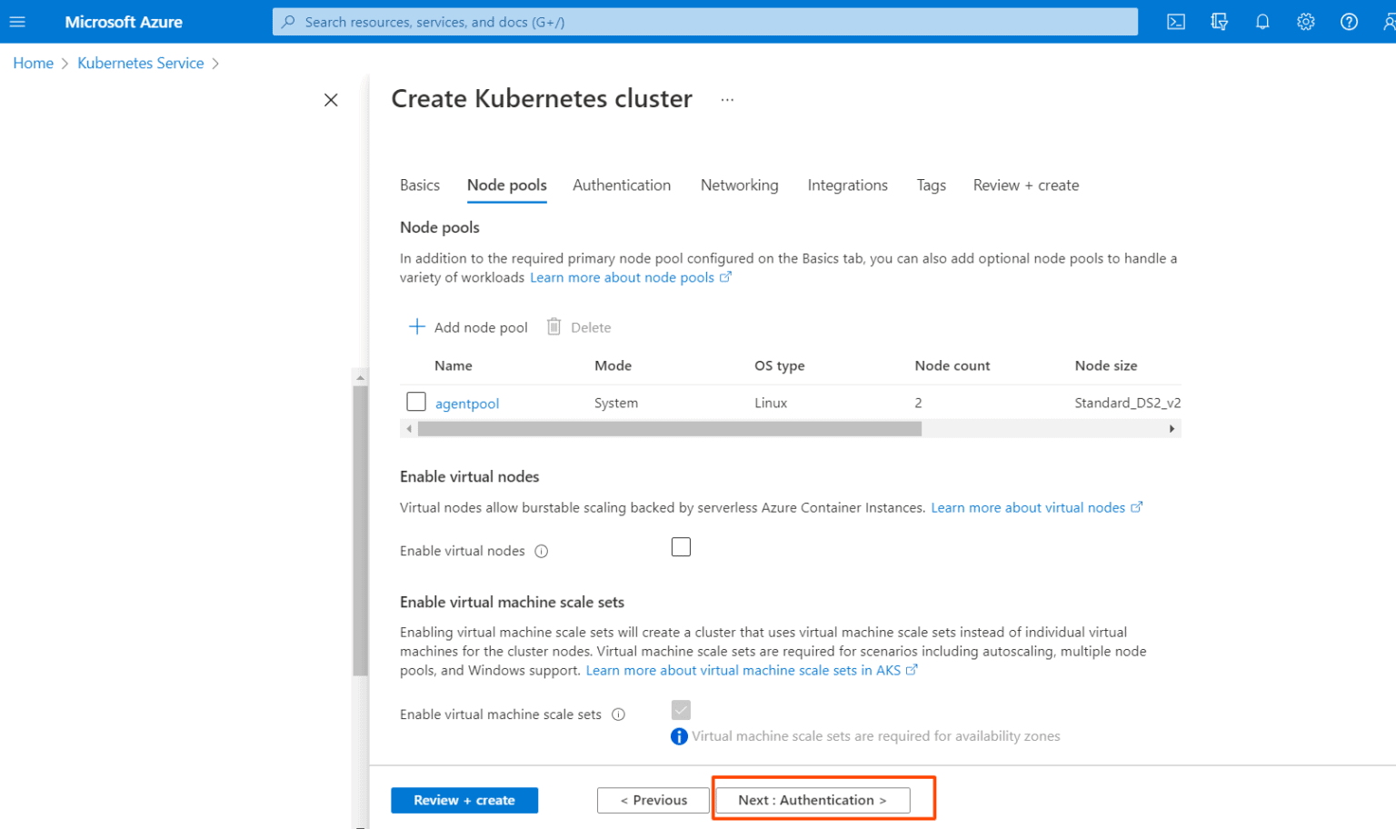
Steps To Create AKS Cluster (Cont.)
Step 4 [Node Pools]:

Slide 30
Steps To Create AKS Cluster (Cont.)
Step 5 [Authentication]: Next is to click on Authentication.
Choose the System-assigned managed identity.
If you want to go for Role-based Access Control (RBAC) then select Enabled.
We can use both RBAC & Azure Active Directory for Authentication.
Note: Here in this step-by-step guide, we are using both RBAC & Azure AD for authentication.
Check the Azure Active Directory option.
Create a group in Active Directory and add it.
Choose the Encryption Type of your choice, I will use the Default one

Slide 31
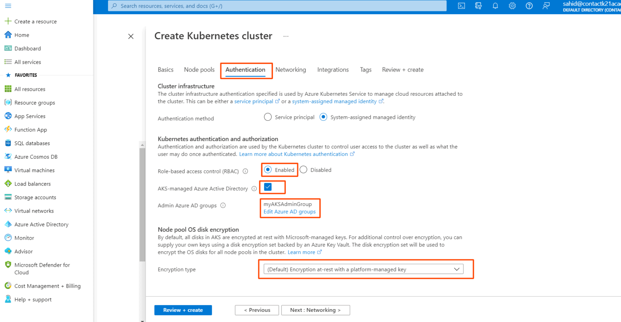
Steps To Create AKS Cluster (Cont.)
Step 5 [Authentication]:

Slide 32
Steps To Create AKS Cluster (Cont.)
Step 6 [Networking]: Next is the Networking part.
Select the Network Configuration. I will be choosing Azure CNI
The Cluster Subnet option is to choose which Subnet you want the Nodes and Containers to be placed in.
Kubernetes service address range is the CIDR notation IP range from which to assign server cluster IPs.
Docker Bridge address is the IP address assigned to Docker Bridge. The Bridge Network is for the container to container communication.
In Private Cluster, the communication between the nodes and the API server happens internally.
So, I am Disabling the Private Cluster.
Keep the Network Policy to Azure.
Do not enable HTTP application routing.

Slide 33
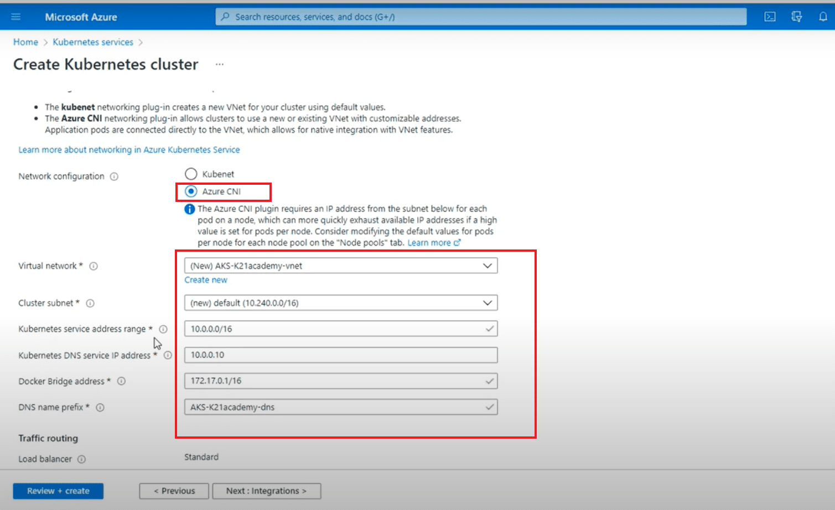
Steps To Create AKS Cluster (Cont.)
Step 6 [Networking]:

Slide 34
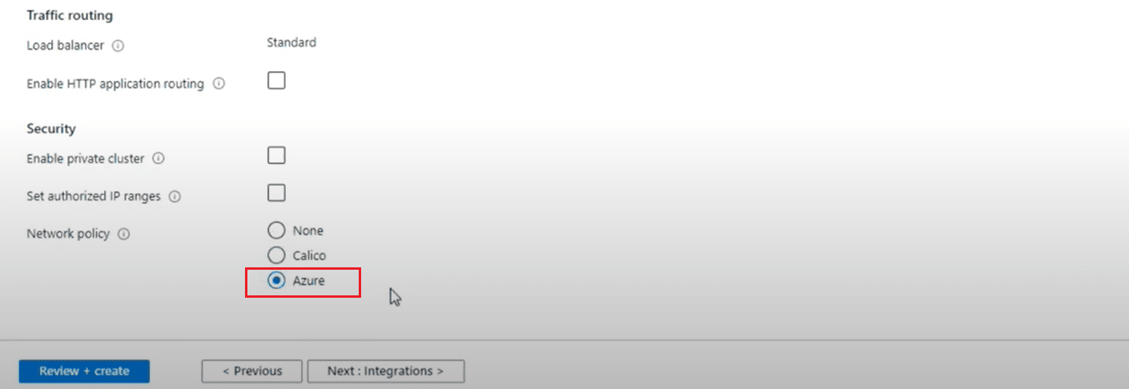
Steps To Create AKS Cluster (Cont.)
Step 6 [Networking]:

Slide 35
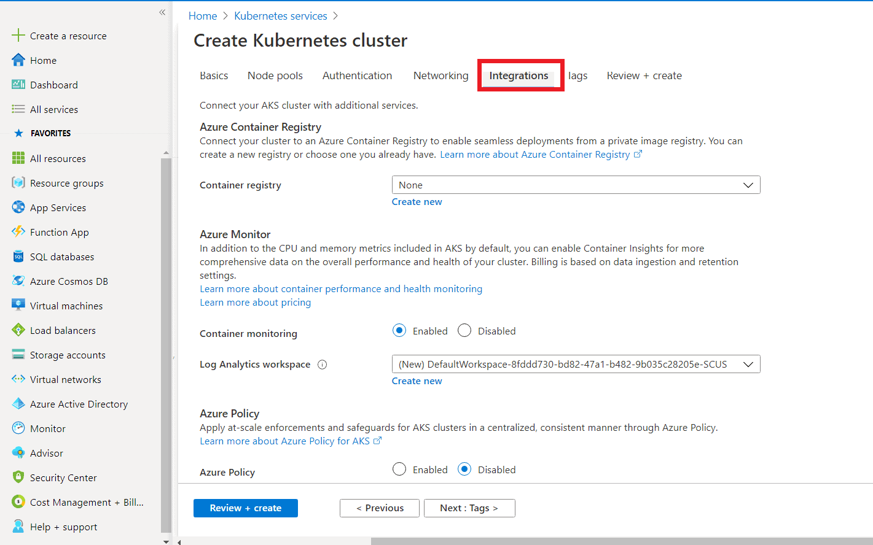
Steps To Create AKS Cluster (Cont.)
Step 7 [Integration]: Next is the Integration.
  Here we keep all settings to default and move to the next step.

Slide 36
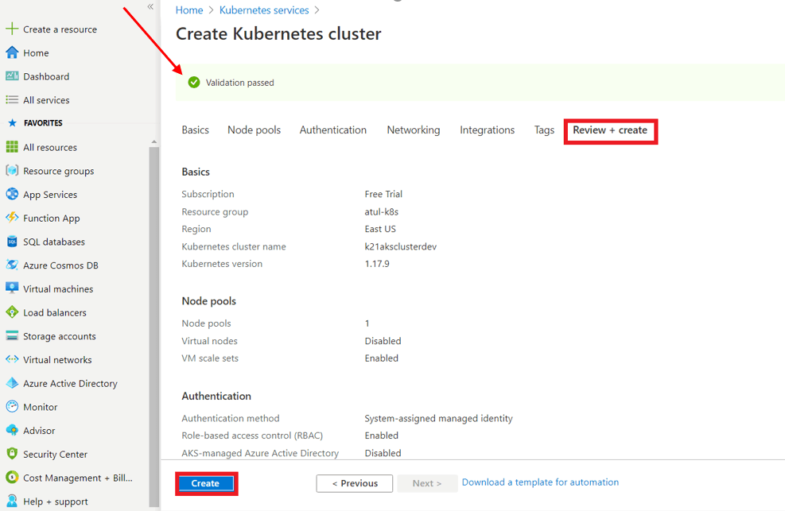
Steps To Create AKS Cluster (Cont.)
Step 8 [Review & Create]: The final step is to click on Review & Create. If you click on Create, it will first Validate your AKS Cluster and if everything is fine then the cluster will be created.

Slide 37
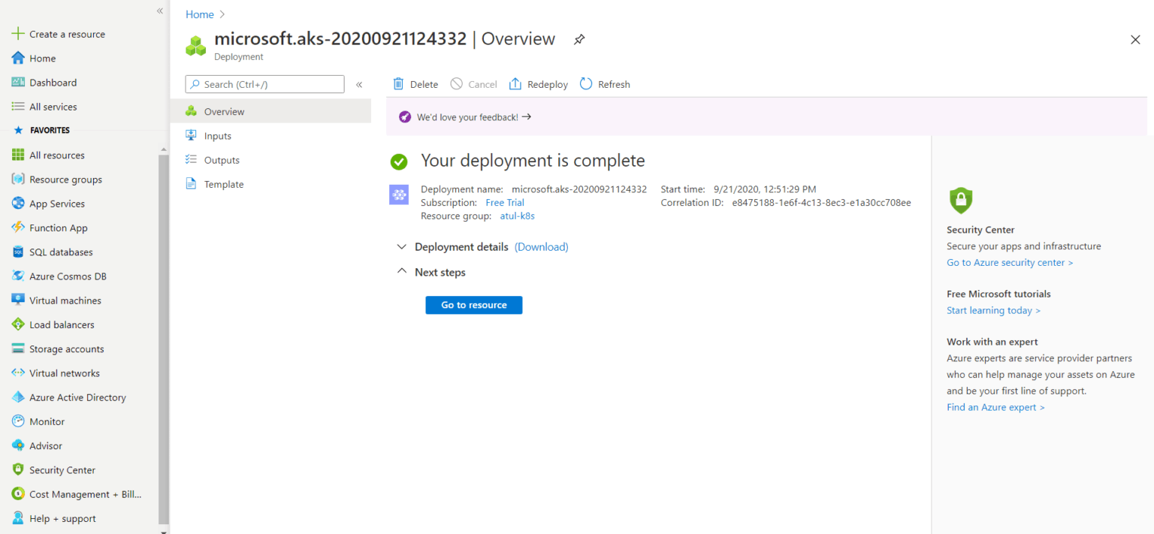
Steps To Create AKS Cluster (Cont.)
You can see that our new Azure Kubernetes cluster has been successfully created. Yayyy! But hold on, we will have to connect this cluster, which I am going to cover next.

Slide 38
Connect to the Azure Kubernetes Cluster
There are two ways to connect the AKS cluster:
  Using Cloud Shell
  Using Azure CLI

Slide 39
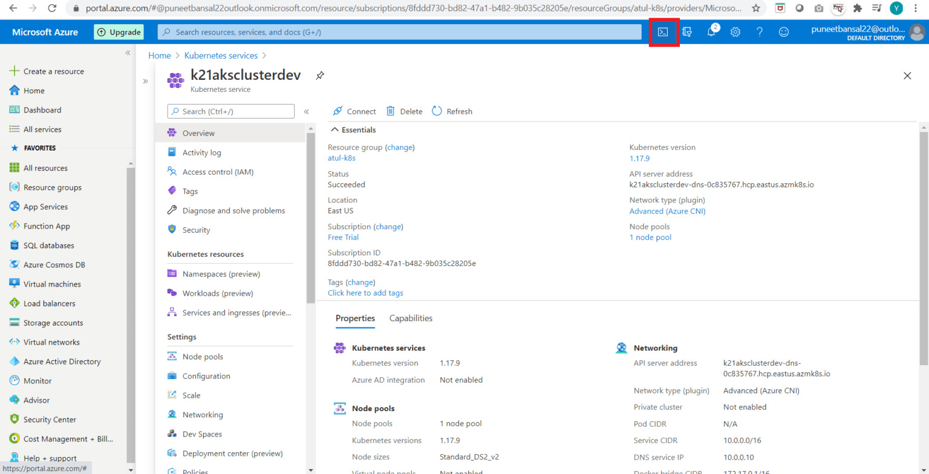
Connect to the Azure Kubernetes Cluster (Cont.)
Now going to cover how do we connect using Cloud Shell. We can see the option on top of our screen (marked red in the below image).

Slide 40
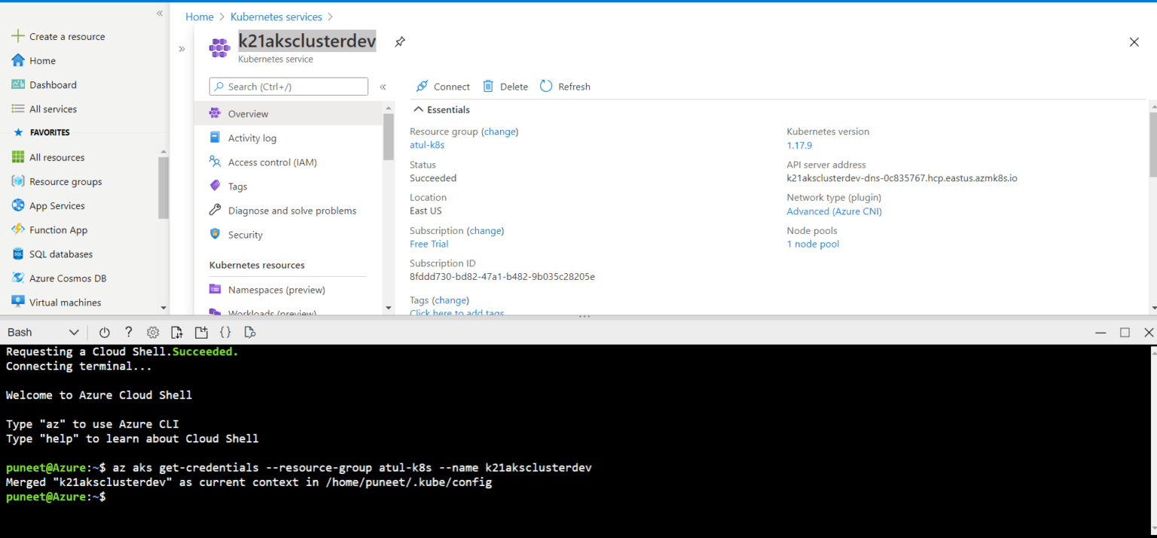
Connect to the Azure Kubernetes Cluster (Cont.)
Step 1: Run the following command, on the Azure bash shell.
$ az aks get-credentials --resource-groups <name of resource group> --name <name of cluster

Slide 41
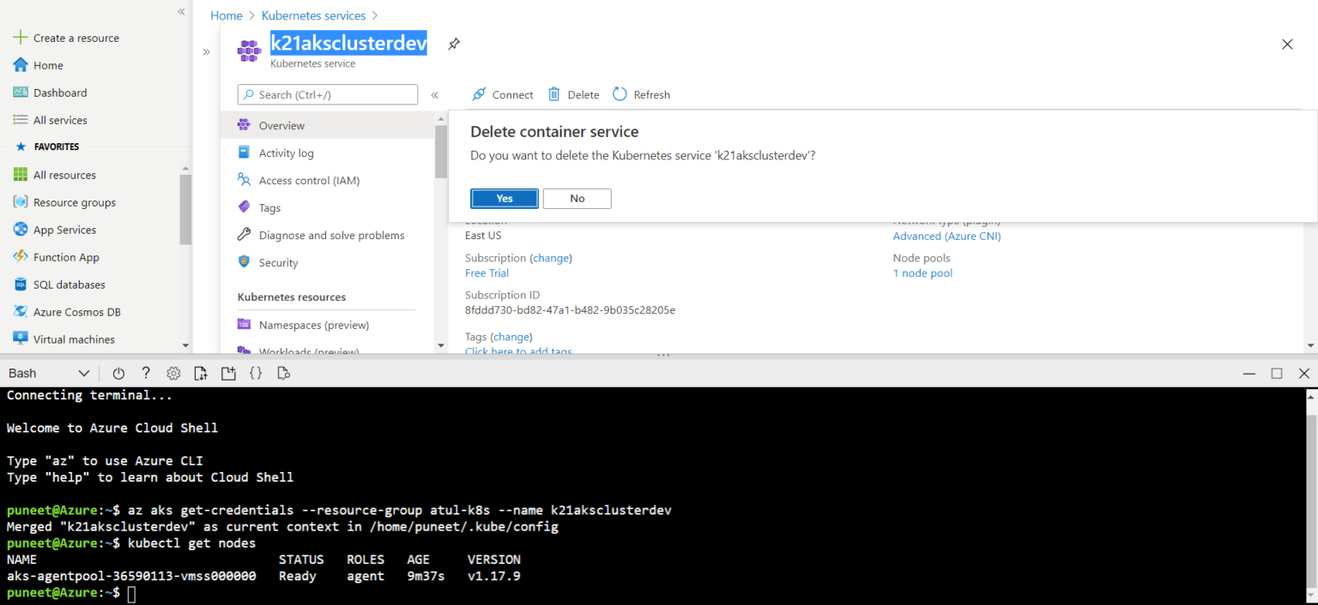
Connect to the Azure Kubernetes Cluster (Cont.)
Step 2: To get the Nodes running in our cluster, run the following command, and you will see all the nodes in your AKS cluster.
$ kubectl get nodes

Slide 42
Thanks
…?

